Slide 1
UNIT 3

Slide 2
JavaScript Events

Slide 3
What are Events?

Slide 4
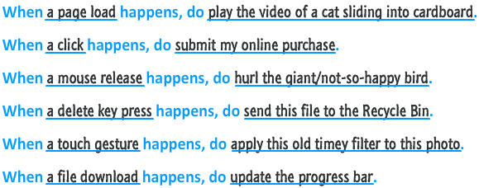
EXAMPLES OF EVENTS

Slide 5
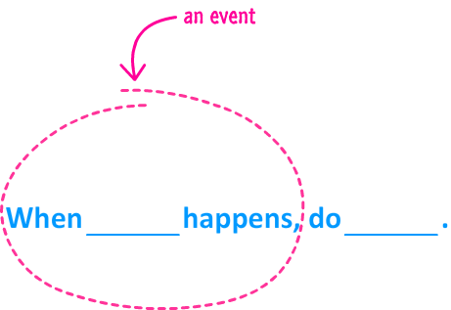
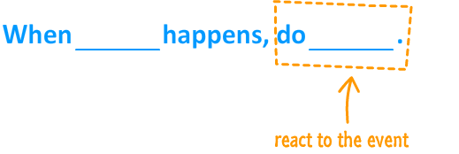

Slide 6
Events
An event is a signal.
It communicates that something has just happened. This could be a
mouse click
a key press on the keyboard
a window getting resized.
a document simply getting loaded
Events define the thing that happens. They fire the signal.
The second part of the model is defined by the reaction to the event

Slide 7
Javascript Events
To work with events, there are two things you need to do:
Listen for events
inline model
traditional model
W3C model
React to events

Slide 8
Inline Model
<body>
<input type="button" id="askme" value="Ask me" onclick="ask()"/>
<script>
function ask(){
var a =window.prompt("Please ask a question")
alert("I am sorry I don't know the answer")
}
</script>
</body>

Slide 9
Traditional Model
<body>
<input type="button" id="askme" value="Ask me"/>
<script>
var a=document.getElementById("askme");
a.onclick=ask;
function ask(){
var a =window.prompt("Please ask a question")
alert("I am sorry I don't know the answer")
</script>
</body>

Slide 10
W3C Model
<body>
<input type="button" id="askme" value="Ask me" />
<script>
var a=document.getElementById("askme");
a.addEventListener("click",ask,false)
function ask(){
var a =window.prompt("Please ask a question")
alert("I am sorry I don't know the answer")
}
</script>
</body>

Slide 11
Common Events
Event | Event is fired...
click | ...when you press down and release the primary mouse button / trackpad /
mousemove | ...whenever your mouse cursor moves
mouseover | ...when you move the mouse cursor over an element. This is the event you would use for detecting a hover!
mouseout | ...when your mouse cursor moves outside the boundaries of an element.
dblclick | ...when you quickly click twice.
contextmenu | …when you right-clicks the mouse
load | ...when your entire document (DOM, external stuff like images, scripts, etc.) have fully loaded.
keydown | ...when you press down on a key on your keyboard
keyup | ...when you release a key press on your keyboard
scroll | ...when an element is scrolled around

Slide 12
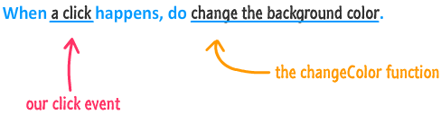

Slide 13
Event
Event Handler
Functions that handle events
Registering Events
Assign an event handler to a DOM node

Slide 14
onmouseover , onmouseout,Onmousemove
When the mouse cursor enters an element, an onmouseover event occurs for that element
When the mouse cursor leaves the element, an onmouseout event occurs for that element
onmousemove event fires whenever the user moves the mouse

Slide 15
event Object & this
event object stores information about the event that called the event-handling function
The target event (event.target) property returns the element that triggered the event. The target property gets the element on which the event originally occurred.
In an event-handling function, this refers to the DOM object which fired the event handler
this keyword enables one event handler to apply a change to one of many DOM elements, depending on which one received the event

Slide 16
event Object Properties

Slide 17
Keyboard , form & load events

Slide 18
Form Processing with onfocus and onblur
onfocus event fires when an element gains focus
i.e., when the user clicks a form field or uses the Tab key to move between form elements
onblur fires when an element loses focus
i.e., when another control gains the focus

Slide 19
More Form Processing with onsubmit and onreset
onsubmit and onreset events fire when a form is submitted or reset, respectively
Anonymous function
A function that is defined with no name
Created in nearly the same way as any other function, but with no identifier after the keyword function
Useful when creating a function for the sole purpose of assigning it to an event handler
confirm method asks the users a question, presenting them with an OK button and a Cancel button
If the user clicks OK, confirm returns true; otherwise, confirm returns false

Slide 20
onload Event
Whenever and element finishes loading
Generally used with the body element
Demo: A program to calculated how many seconds elapsed since document loaded

Slide 21
<html>
<head>
<title>onload Event</title>
<script type = "text/javascript">
var seconds = 0;
function startTimer()
{ window.setInterval( "updateTime()", 1000 ); }
function updateTime()
{
++seconds;
document.getElementById( "soFar" ).innerHTML = seconds;
}
</script>
</head>
<body onload = "startTimer()">
<p>Seconds you have spent viewing this page so far:
<strong id = "soFar">0</strong></p>
</body>
</html>

Slide 22
LOAD EVENT (Images)
<img src=“tulips.png" onload="loadImage()" width="100"height="132"> <script> function loadImage() { alert("Image is loaded"); } </script>

Slide 23
Meet the Keyboard Events
keydown
Keypress - the keypress event is fired only when you press down on a key that displays a character
keyup

Slide 24
EXAMPLE
Here is an example of me listening to our three keyboard events on window:
window.addEventListener("keydown", dealWithKeyboard, false); window.addEventListener("keypress", dealWithKeyboard, false); window.addEventListener("keyup", dealWithKeyboard, false);
function dealWithKeyboard(e) { // gets called when any of the keyboard events are overheard }

Slide 25
The Keyboard Event Properties
keyCode Every key you press on your keyboard has a number associated with it. This read only property returns that number.
charCode This property only exists on event arguments returned by the keypress event, and it contains the ASCII code for whatever character key you pressed.
ctrlKey, altKey, shiftKey These three properties return a true if the Ctrl key, Alt key, or Shift key are pressed.
metaKey The metaKey property is similar to the ctrlKey, altKey, and shiftKey properties in that it returns a true if the Meta key is pressed. The Meta key is the Windows key on Windows keyboards and the Command key on Apple keyboards

Slide 26
EVENT BUBBLING

Slide 27
Event Bubbling
events ripple and affect a bunch elements that lie in their path

Slide 28
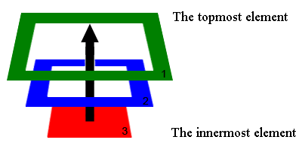
Event Bubbling
The bubbling guarantees that click on Div 3 will trigger onclick first on the innermost element 3
(also caled the target), then on the element 2, and the last will be element 1.

Slide 29
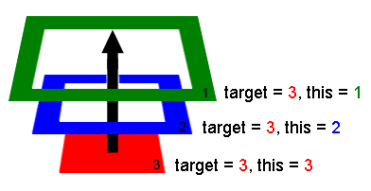
The deepest element which triggered the event is called the target or, the originating element.
When handlers trigger on parents:
event.target/srcElement - remains the same originating element.
this - is the current element, the one event has bubbled to, the one which runs the handler.

Slide 30
<body id="theBody" class="item">
<div id="one_a" class="item">
<div id="two" class="item">
<div id="three_a" class="item">
<button id="buttonOne" class="item">one</button>
</div>
<div id="three_b" class="item">
<button id="buttonTwo" class="item">two</button>
<button id="buttonThree" class="item">three</button>
</div>
</div>
</div>
<div id="one_b" class="item">
</div> </body>

Slide 31
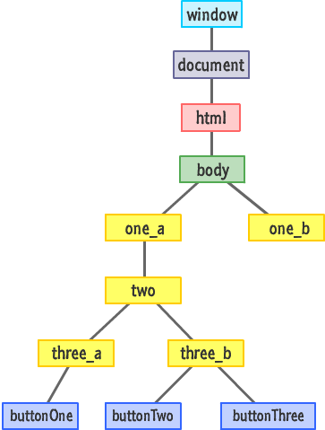

Slide 32
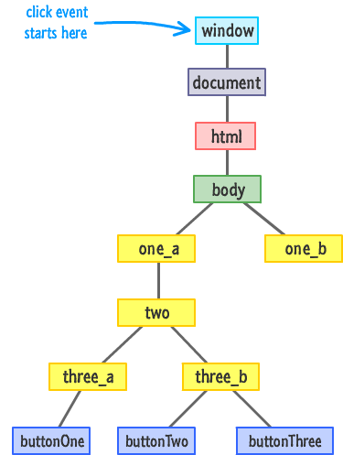

Slide 33
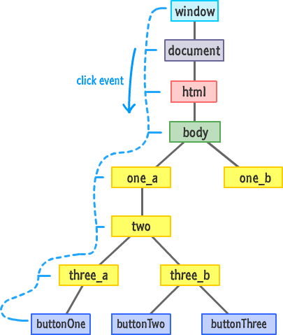

Slide 34
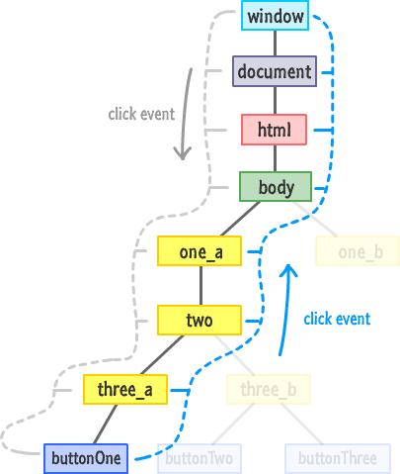

Slide 35
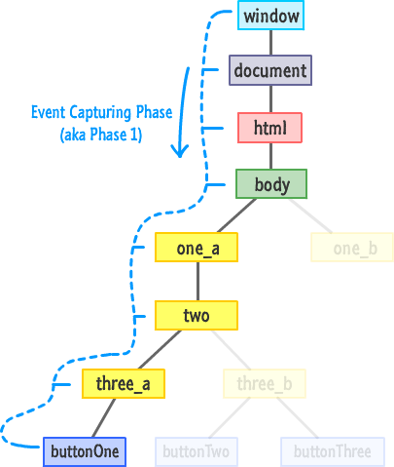

Slide 36
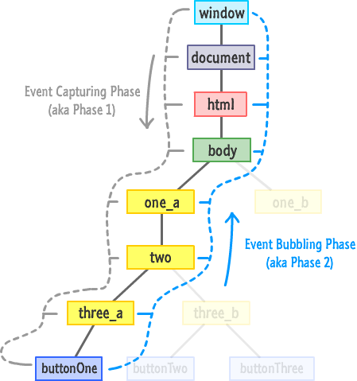

Slide 37
TIMERS & SYNTHETIC EVENTS

Slide 38
TIMERS
setTimeout,
setInterval

Slide 39
Settimeout
The setTimeout function allows you to delay executing some code
This function allows you to specify what code to execute and how many milliseconds to wait before the code you specified executes.
Putting that into JavaScript, it will look something like this:
var timeID = window.setTimeout(someFunction, delayInMilliseconds);
timeID variable that is initialized to the setTimeout function.
This variable can be used to cancel the timer as shown below
window.clearTimeout(timeID);
Can you think of some applications for setTimeout??

Slide 40
setinterval
The setIntervalfunction is similar to setTimeout in that it also allows you to execute code after a specified amount of time. It keeps on executing the code in a loop forever at the specified interval
Example
var intervalID = window.setInterval(someFunction, delayInMilliseconds);
The first argument specifies the inline code or function you would like to execute. The second argument specifies how long to wait before your code loops again.
The setInterval function can be initialized to a variable that can be later used to do cancel the looping.
window.clearInterval(intervalID);

Slide 41
SYNTHETIC EVENTS
Used to create and dispatch DOM events

Slide 42
Creating custom events
Events can be created with the Event constructor as follows:
var event = new Event('build');
// Listen for the event.
elem.addEventListener('build', function (e) { ... }, false);
// Dispatch the event.
elem.dispatchEvent(event);

Slide 43
Adding custom data – CustomEvent()
To add more data to the event object, the CustomEvent interface exists and the detail property can be used to pass custom data.
For example, the event could be created as follows:
var event = new CustomEvent('build', { detail: elem.dataset.time });
This will then allow you to access the additional data in the event listener:
function eventHandler(e) {
console.log('The time is: ' + e.detail);
}

Slide 44
JS Cookies
Refer: https://www.tutorialspoint.com/javascript/javascript_cookies.htm

